Slide 1

TRAIT MODEL
Trait EI evaluates how an individual perceives their emotional abilities. -Konstantinos Vasilis Petrides
Notes:
https://www.goodtherapy.org/emotional-intelligence.html
Konstantinos Vassilis Petrides

Slide 2
The Trait Model of Emotional Intelligence was first developed by psychologist Konstantinos Vasilis Petrides.
He provides a very different understanding of Emotional Intelligence than the Ability Model.
While the Ability Model is highly logical and focuses on outward results, the Trait Model is geared more toward emotional self-perception.

Slide 3
One of the most recent models of EI was published in 2009 by Petrides and colleagues and marks a break from the idea that emotional intelligence is ability-based.
Instead, it proposes that people have, as part of their personalities, a number of emotional self-perceptions and emotional traits (characters).
These emotional abilities, and their perception of them, then affect their behaviors and perceived cognitive and behavioral abilities.

Slide 4
The Trait Model of Emotional Intelligence essentially has to be conducted within a framework of understanding an individual's personality.
Because it relies so heavily on personality characteristics, it is impossible to evaluate someone's EQ using the Trait Model without performing a personality evaluation.

Slide 5
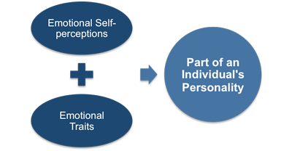

Slide 6
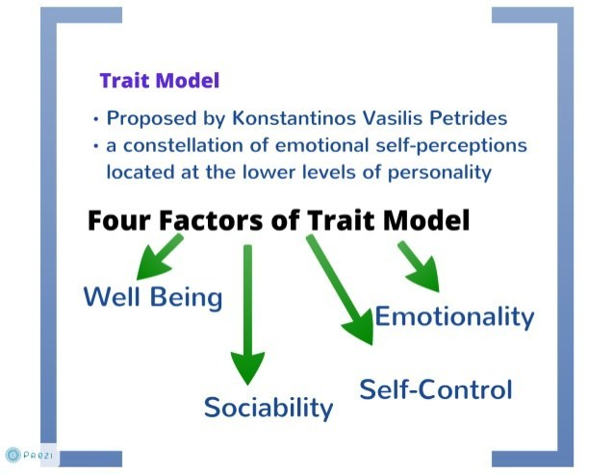

Slide 7
These traits aren't measured in the scientific sense, but are instead measured by the respondent's self-report.
This assumes that the respondent is able to accurately describe his or her own traits

Slide 8
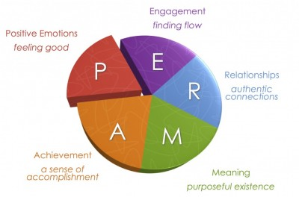
PERMA model

Slide 9
TEIQue - abbreviation stands for 'Trait Emotional Intelligence Questionnaire.
This model of emotional intelligence can only be viewed in combination with a full investigation of a person's personality.
This is distinct from the other models, which suggests that EI is a brain-based ability, not an environmental aspect of personality.

Slide 10
Summary
Konstantinos Vasilis Petrides defined the trait model as
"a constellation of emotional self-perceptions located at the lower levels of personality.“

